Slide 1
Holiday Destination Performance Result 2020
By Grace U.

Slide 2
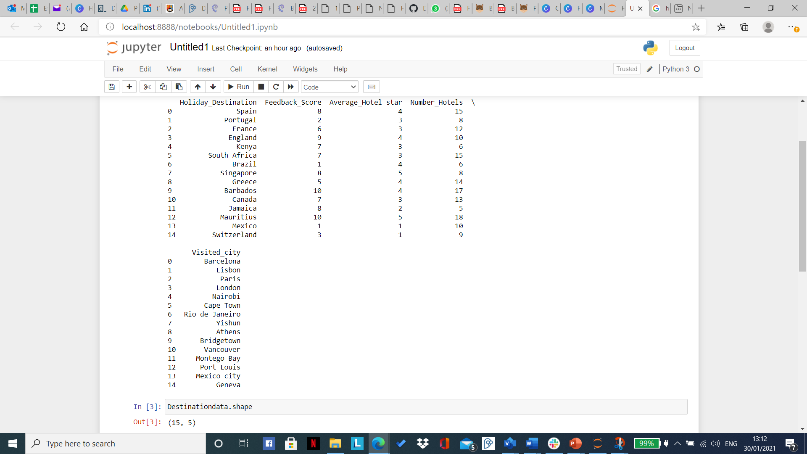

Numbers of rows and columns

Slide 3
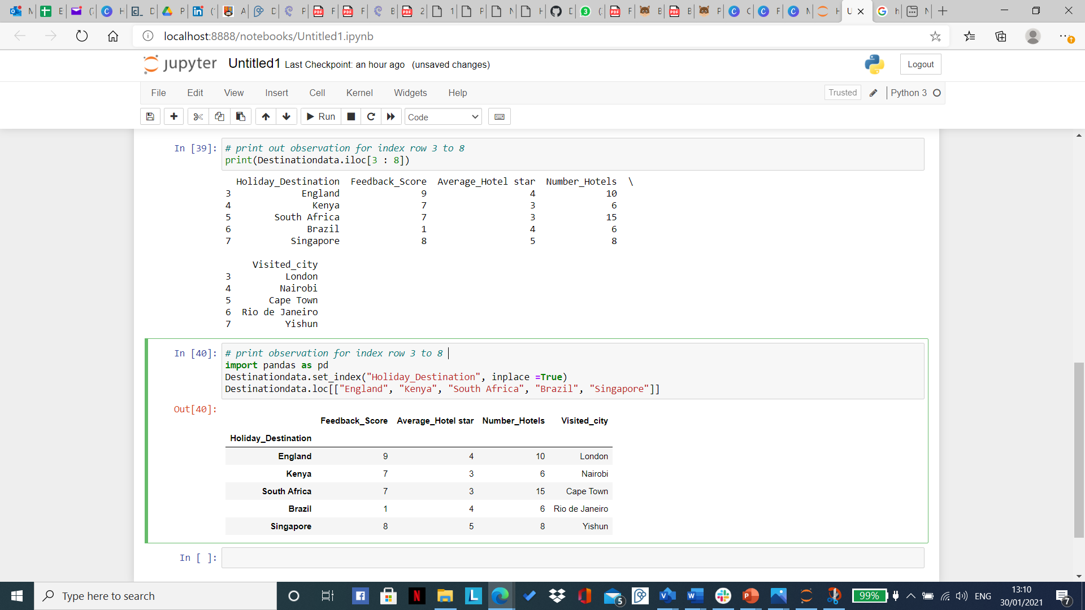
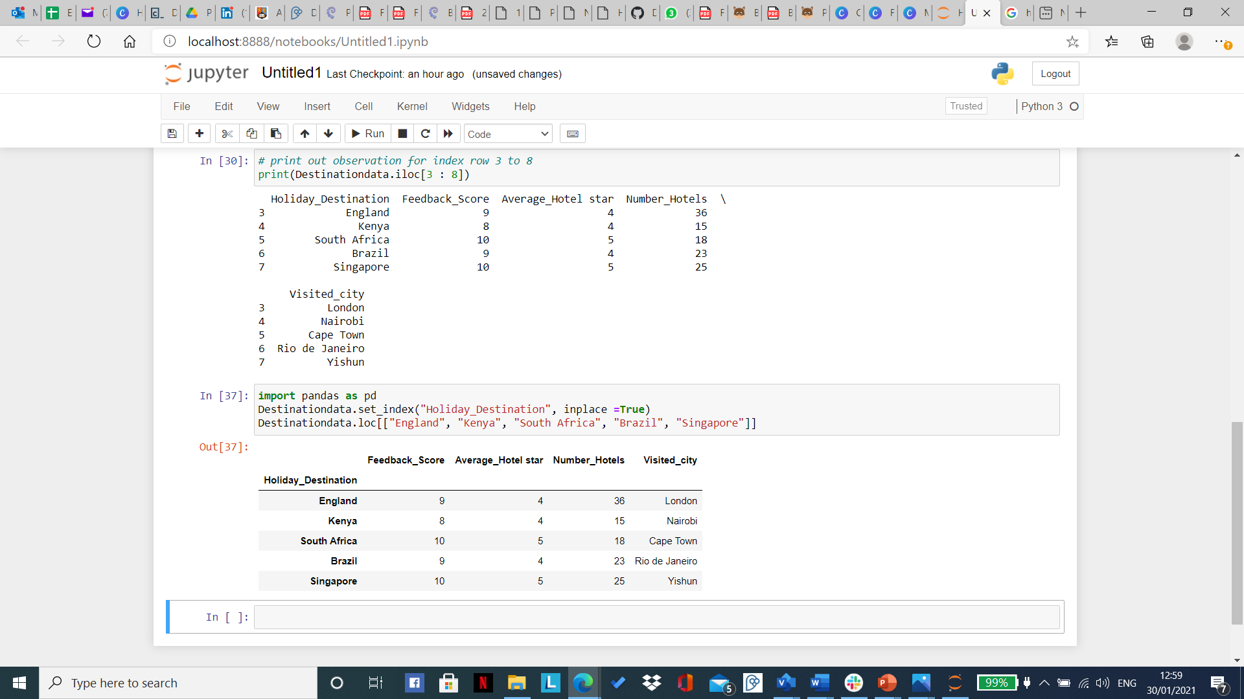
Print row 3-8 (using iloc/loc)

Slide 4
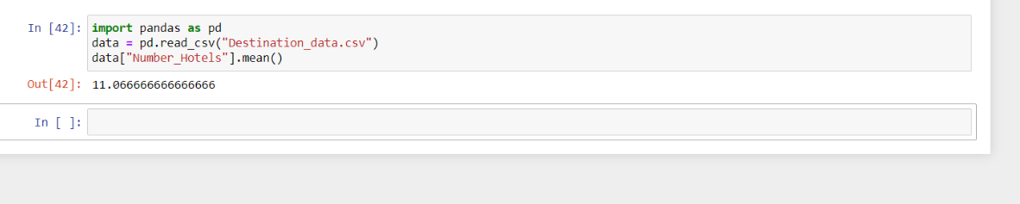
Find the mean number off all inclusive hotels across all destination

Slide 5
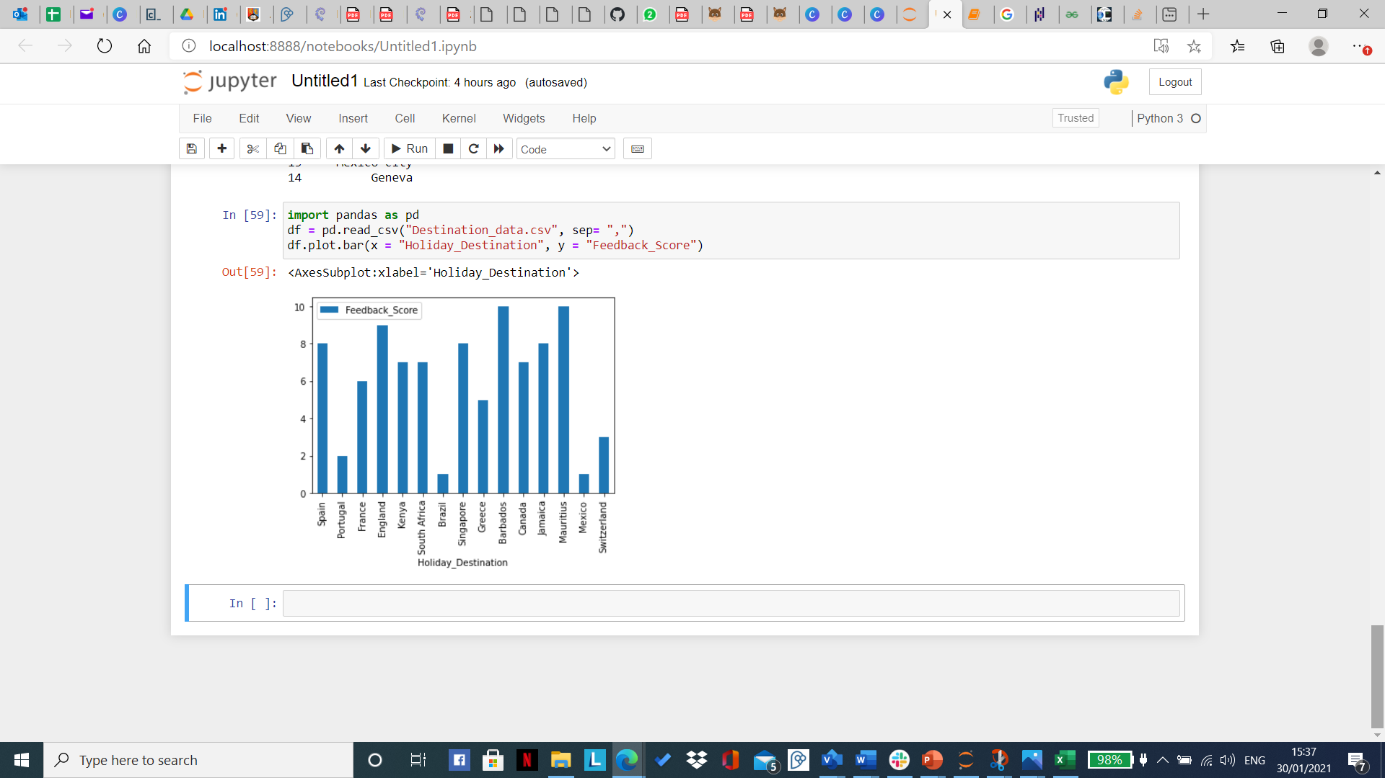
The lowest scoring destination

Slide 6
The Highest scoring destination

Slide 7
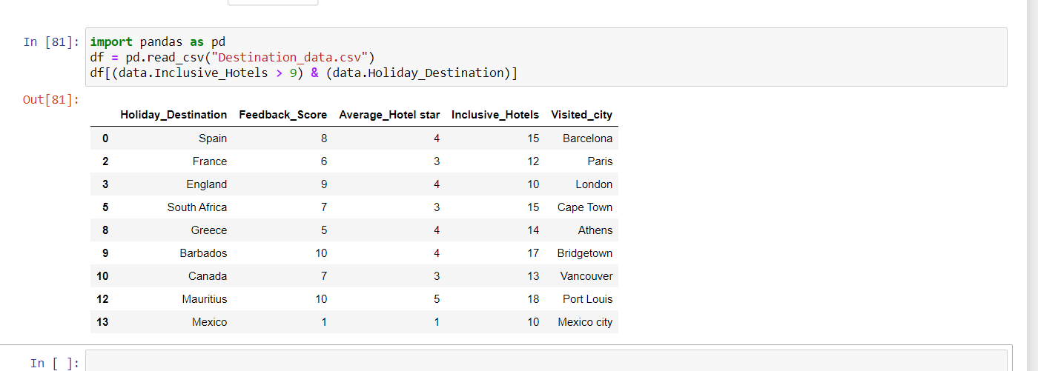
All destinations with more than 9 all inclusive hotels

Slide 8
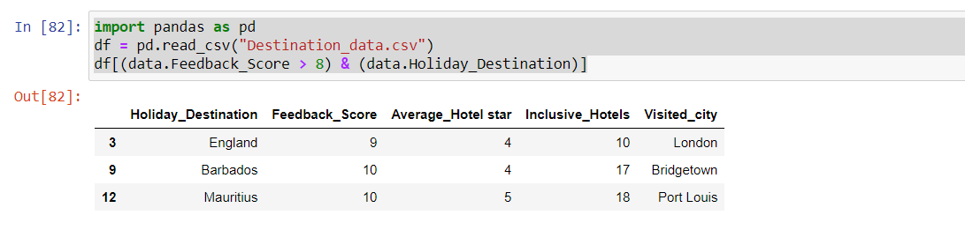
Destination with Feedback score of above 8

Slide 9
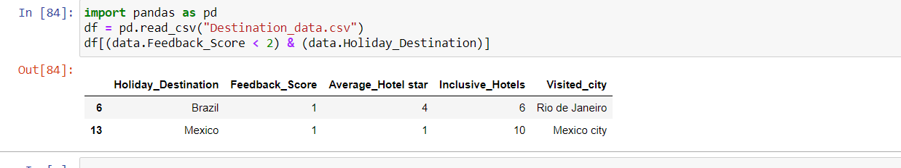
Destination with Feedback score of less than 2

Slide 10
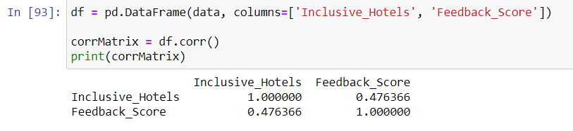
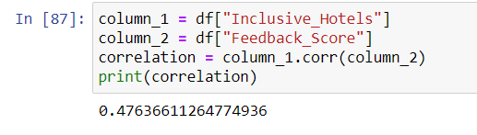
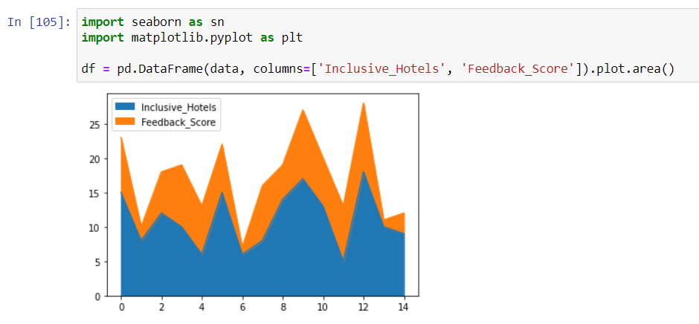
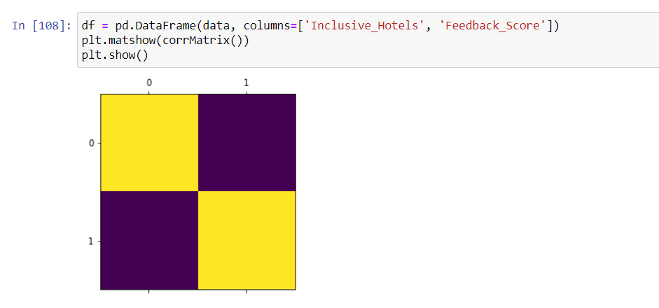
Correlation all Inclusive hotels and feedback score
There is a moderate correlation between all inclusive hotels and Feedback scores

Slide 11
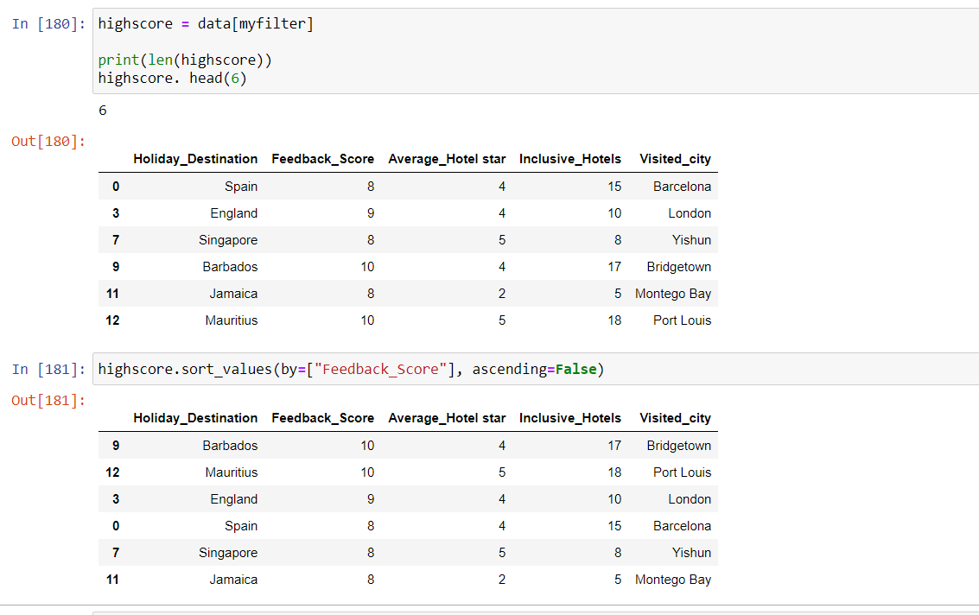
Data Visualization diagram showing destination and highest scores

Slide 12
Recommendation
From our dataset , Barbados, Mauritius, England, Spain and Singapore have got the highest feedback score and average star rating which shows the customers are happy travelling to those destinations.
Jamaica has a high feedback score but rating is quite low, it may be that some of the hotels within the all inclusive are not up to standard and would need to be reviewed.
Brazil has a low feedback and a good star rating, I would advise we reach out to the customers to understand why their feedback was low, before making any decisions to remove them from our destination list.
Finally Mexico seems to be struggling in all 10 inclusive hotels. We could look to remove them from our destination list and review other hotels around Mexico city that has a higher ratings.

